Slide 1
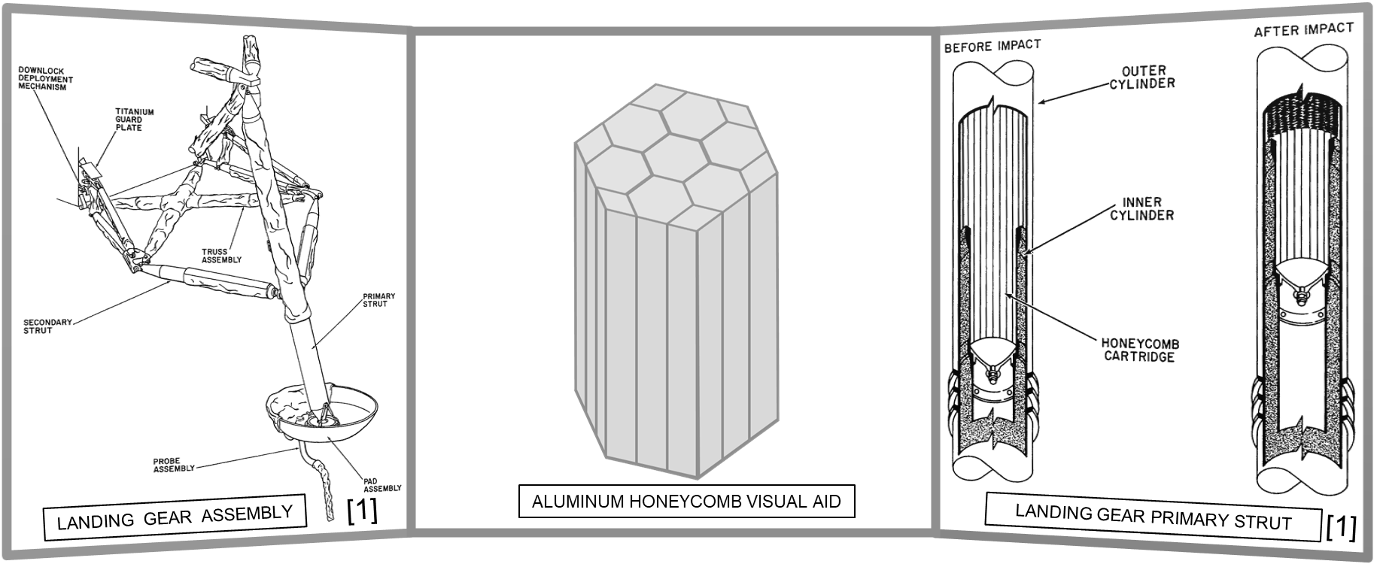
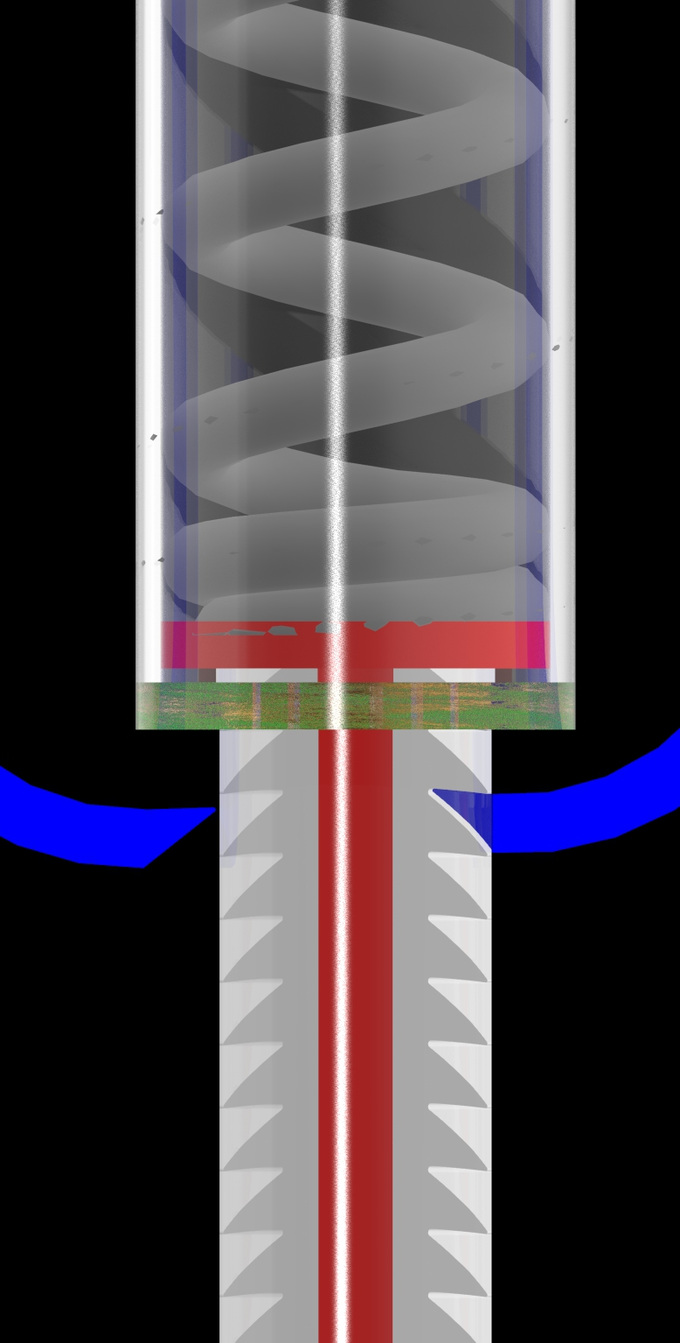
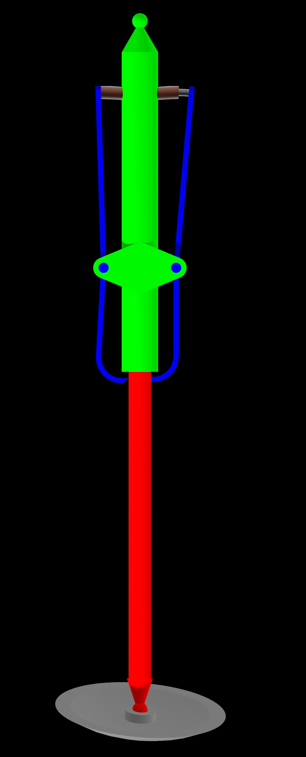
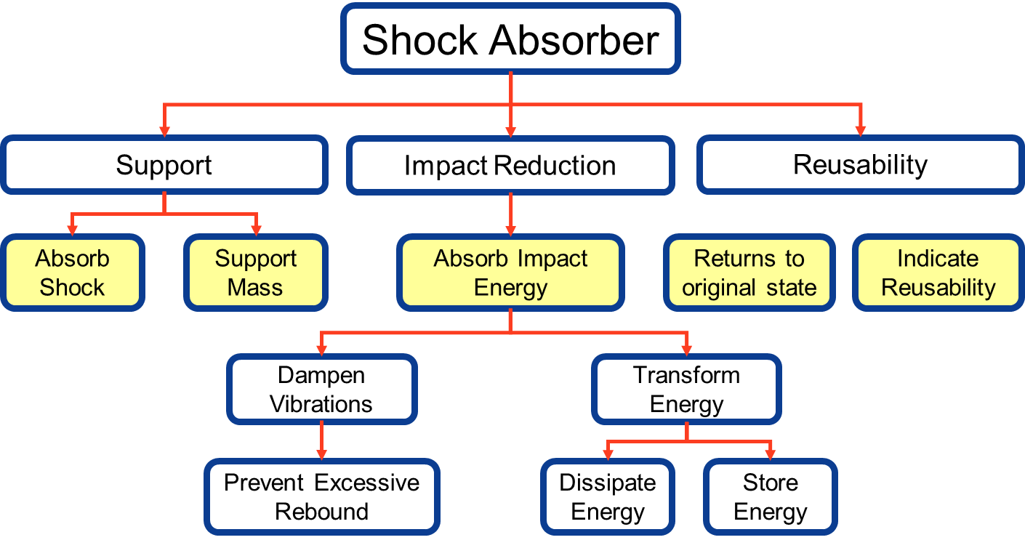
T515: Reusable Shock Absorber for New Lunar Lander
Josh Blank | Matt Fowler | Tristan Jenkins | Alex Noll | Melanie Porter
We would like to thank our: Sponsor: Rachel McCauley Instructor: Dr. Shayne McConomy Advisor: Keith Larson
Project Description
Project Motivation
To design a reusable device for the human lander system that will dissipate the impact energy in such a way that it does not damage the vessel or occupants.
Mission Artemis is the first step to putting humans on the surface of Mars. It will establish a human presence on the moon to act as a steppingstone to Mars. Our project will allow for long-term and sustainable transit between the lunar surface and the lunar space station, Gateway.
Working Design
1
6
Previous Lander Shock Absorber
Connection to lander
Pawl arm
Pawl Pin
Circular I-Beam
Connection to footpad
Solenoid
Ferritic core
Upper strut cylinder
Main spring
Main piston
Bushing
Ratchet teeth inside of I-beam channel
2
7
3
8
9
4
10
11
5
12

Slide 2
T515: Reusable Shock Absorber for New Lunar Lander
Josh Blank | Matt Fowler | Tristan Jenkins | Alex Noll | Melanie Porter
We would like to thank our: Sponsor: Rachel Advisor: Keith Larson
This PowerPoint template is set up to make it easier to format your poster.
Final poster size is 36 inches by 24 inches. Leave a one inch white margin on all sides – the printer is not able to print to the edges. This format is set up to allow the one-inch margin.
The paper size exceeds that which most desktop printers can accommodate. If you are printing proofs, save the files as pdf and “reduce to fit” or choose to “tile” when you send the file to the printer.
It is suggested that you adopt this 4-column format for your poster presentation, but it is not required. The format allows you flexibility – you can span two or three or even four columns with photos and graphics. When you are presenting your text, following a flow from the top left to the bottom right will help your audience interpret your presentation.
Recommended fonts are Arial for headlines and accent text and Adobe Garamond for paragraphs. The serif font, Garamond, increases readability of large amounts of text.
To create the title of your poster, select the text box tool and click at the top of the poster. Click on the edge of the text box until the dotted margin appears then drag from the corner of text box until it fits from one side of the poster to the other. Type your title text here. Headline font size will be around 72 points. The subhead text box (under the title text box) with its font size around 48 points.
Save your PowerPoint poster file as a PDF and email both the PowerPoint and the PDF to yourself or to Media Staff: trisha@eng.famu.fsu.edu, herring@eng.famu.fsu.edu,
Unfortunately, we can no longer allow users to bring files to us on USB flash drives due to the prevalence of malicious software. We will give you access to webmail on the PC or Mac desktop so that you can save your file to the hard drive and open to review for cross-platform, font and software version conflicts.
It takes an average of 10-15 minutes to print most 24”x 36” posters. If you have used 100% ink coverage, and/or a lot of images, it will take longer to spool and print. We recommend a white background, with no edge-to-edge background images.
Media and Communications (A335) printing hours are: 7:30AM-2:00pm. Please give us a minimum of 48 hours before you need your print job in-hand.
DESIGN NOTE: If you are creating a poster from resources other than individual PPT slides, please re-size all images to 100% of the desired placed size before inserting, to prevent raster image processing (RIP) problems. Image resolution should be no bigger than 300dpi; 150dpi is preferred.
FYI. Use one of the college logos provided at the top of the poster.

